Slide 1
Data Structure practical
PRESENTED BY
MR. N. K. S. YADAV

Slide 2
2.2 Binary search
Definition
Binary Search is a searching technique used to find an element in a sorted array by repeatedly dividing the array into two halves.
Instead of checking each element one by one (like Linear Search), binary search cuts the search area in half every step, making it much faster.

Slide 3
Algorithm
Start
Read number of elements
Input sorted array
Input element to search
Set low = 0 and high = n-1
Find mid = (low + high)/2
If key == arr[mid] → element found
If key < arr[mid] → high = mid - 1
If key > arr[mid] → low = mid + 1
Repeat until low <= high
If not found → display message
Stop

Slide 4
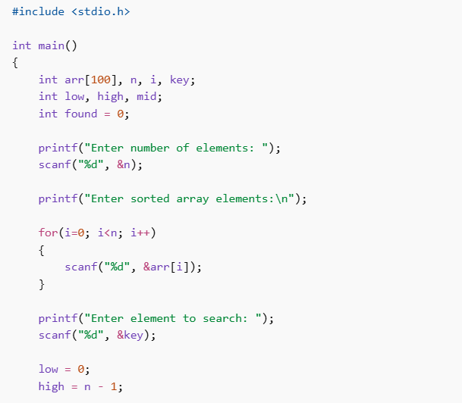
Binary Search C Program

Slide 5
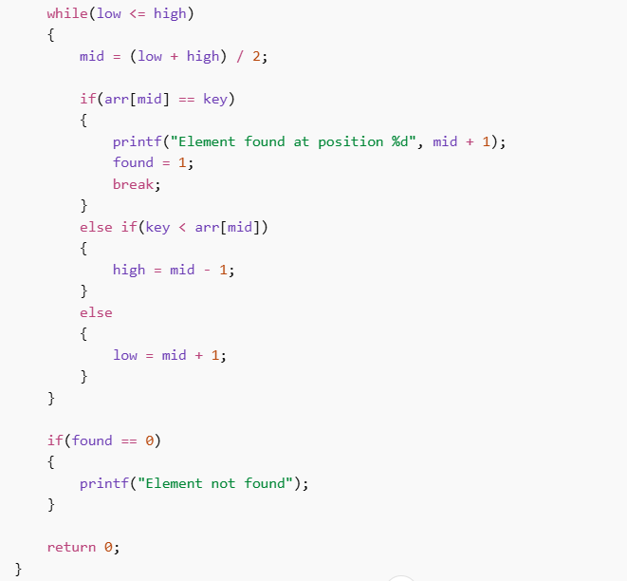
Binary Search C Program

Slide 6
Binary Search C Program
#include <stdio.h> int main() { int arr[100], n, i, key; int low, high, mid; int found = 0; printf("Enter number of elements: "); scanf("%d", &n); printf("Enter sorted array elements:\n"); for(i=0; i<n; i++) { scanf("%d", &arr[i]); } printf("Enter element to search: "); scanf("%d", &key); low = 0; high = n - 1;

Slide 7
Binary Search C Program
while(low <= high) { mid = (low + high) / 2; if(arr[mid] == key) { printf("Element found at position %d", mid + 1); found = 1; break; } else if(key < arr[mid]) { high = mid - 1; } else { low = mid + 1; } } if(found == 0) { printf("Element not found"); } return 0; }

Slide 8
3. Sorting (Bubble, insertion, selection)
Sorting is the process of arranging elements in a particular order, usually ascending (small to large) or descending (large to small).
Example:
Unsorted array
8 3 5 2 9
Sorted array (Ascending)
2 3 5 8 9
Sorted array (Descending)
9 8 5 3 2

Slide 9
Bubble Sort
Bubble Sort repeatedly compares adjacent elements and swaps them if they are in the wrong order.
After every pass, the largest element moves to the end just like a bubble rising to the top of water.

Slide 10
Bubble Sort
Example:
5 2 8 1
Pass 1
5 2 -> swap 2 5 8 1 5 8 -> no swap 8 1 -> swap 2 5 1 8
Pass 2
2 5 -> ok 5 1 -> swap 2 1 5 8
Pass 3
2 1 -> swap 1 2 5 8
Sorted

Slide 11
Bubble Sort
Algorithm
Start
Input array
Compare adjacent elements
Swap if first element is larger
Repeat for all elements
Continue passes until sorted
Stop

Slide 12
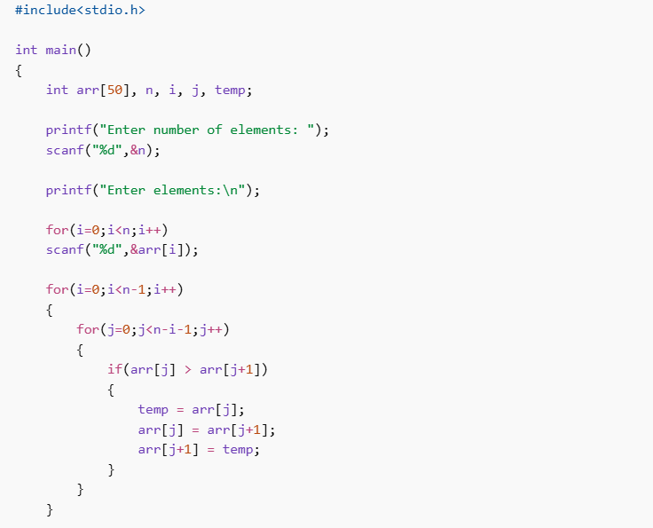
Bubble Sort C Code

Slide 13
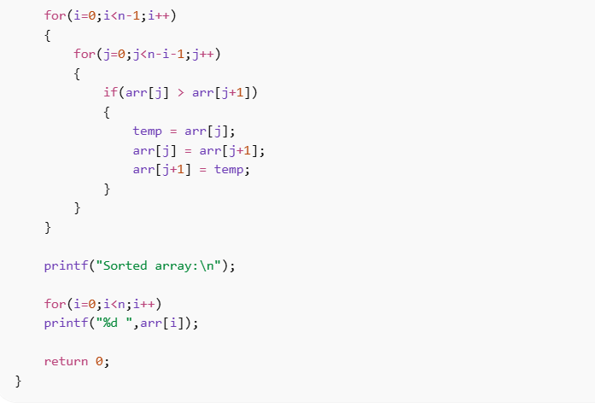
Bubble sort c code

Slide 14
Bubble sort c code
#include<stdio.h> int main() { int arr[50], n, i, j, temp; printf("Enter number of elements: "); scanf("%d",&n); printf("Enter elements:\n"); for(i=0;i<n;i++) scanf("%d",&arr[i]);

Slide 15
Bubble sort c code
for(i=0;i<n-1;i++) { for(j=0;j<n-i-1;j++) { if(arr[j] > arr[j+1]) { temp = arr[j]; arr[j] = arr[j+1]; arr[j+1] = temp; } } } printf("Sorted array:\n"); for(i=0;i<n;i++) printf("%d ",arr[i]); return 0; }

Slide 16
Thankyou!

